Slide 1
Virtual Memory Sample Problems
CDA 3101

Slide 2
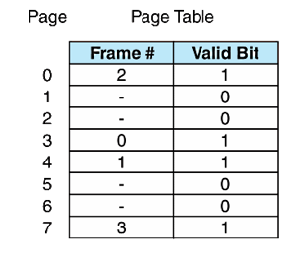
Virtual Memory
Operating systems translate virtual addresses
Page number
A virtual address is divided into two field
Offset
If valid bit = 0 there is page fault
Page number indexes into the Page Map Table to select a Page Table Entry
If valid bit = 1, the frame number is read
Frame number concatenated with offset = physical address

Slide 3
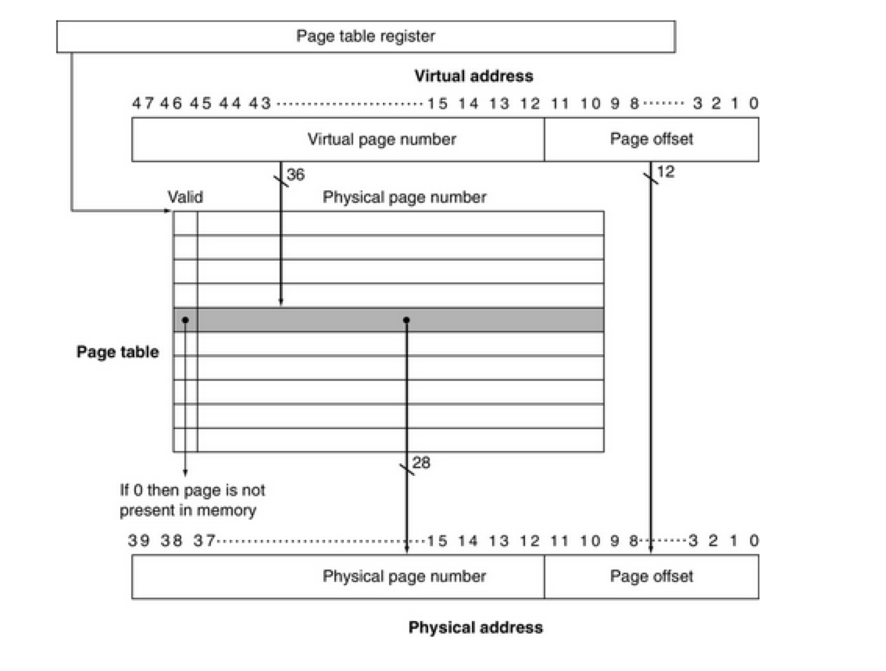
Virtual Address Translation

Slide 4
TLB Lookup Process

Slide 5
Example Problem 1 Step 1
A system has 2¹⁵ bytes of virtual address space. A frame is 2¹⁰ bytes. Physical address space is 2¹³ bytes.
How many bits are in the virtual address?
What is the size of the page field?
What is the size of the offset field?
How many bits are in the physical address?
What is the size of the frame field?
What is the size of the offset field?

Slide 6
Example Problem 1 Step 2
A system has 2¹⁵ bytes of virtual address space. A frame is 2¹⁰ bytes. Physical address space is 2¹³ bytes.
How many bits are in the virtual address?
15 bits
What is the size of the page field?
15-10 = 5 bits
What is the size of the offset field? 10 bits
How many bits are in the physical address? 13 bits
What is the size of the frame field? 13-10 = 3 bits
What is the size of the offset field? 10 bits

Slide 7
Example Problem 2 Step 1

Slide 8
Example Problem 2 Step 2
A system has 2¹⁵ bytes of virtual address space. A frame is 2¹⁰ bytes. Physical address space is 2¹³ bytes.
A system wants to access the following virtual address:
0x5EDA
Is it in main memory?
If so translate the virtual address to a physical address.

Slide 9
Example Problem 2 Step 3
A system has 2¹⁵ bytes of virtual address space. A frame is 2¹⁰ bytes. Physical address space is 2¹³ bytes.
A system wants to access the following virtual address:
0x5EDA
0101 1110 1101 1010
10111 1011011010
Is it in main memory? Yes
If so translate the virtual address to a physical address.
100 1011011010
1 0010 1101 1010
0x12DA

Slide 10
Example Problem 3 Step 1
A system has 2¹⁵ bytes of virtual address space. A frame is 2¹⁰ bytes. Physical address space is 2¹³ bytes.
A system wants to access the following virtual address:
0x25D8
Is it in main memory?
If so translate the virtual address to a physical address.

Slide 11
Example Problem 4 Step 1
The following virtual bytes are requested:
0x123d, 0x08b3, 0x365c, 0x871b, 0xbee6, 0xc049
For each access, is it a hit in the TLB?
Is it a hit in the page table?
A page fault?
What is the updated TLB?
Assume page sizes are 2¹² bytes
If pages must be brought in from disk, increment the page number to get the physical page
Offset = 12 bits
123d = 0001 0010 0011 1101
Tag = 0001 =0x1, miss in TLB
Frame = 1, page fault
Index | Valid | Physical Page or in Disk | Time Since Last Access
0 | 1 | 5 | 4
1 | 0 | disk
2 | 0 | disk
3 | 1 | 6 | 1
4 | 1 | 1 | 7
5 | 1 | 2 | 5
6 | 0 | disk
7 | 1 | 4 | 2
8 | 0 | disk
9 | 0 | disk
a | 1 | 3 | 9
b | 1 | 7 | 3
c | 0 | disk
d | 0 | disk
e | 1 | 0 | 10
Valid | Tag | Physical Page Number | Time Since Last Access
1 | 0xb | 7 | 3
1 | 0x7 | 4 | 2
1 | 0x3 | 6 | 1
1 | 0x4 | 1 | 7

Slide 12
Example Problem 4 Step 2
The following virtual bytes are requested:
0x123d, 0x08b3, 0x365c, 0x871b, 0xbee6, 0xc049
For each access, is it a hit in the TLB?
Is it a hit in the page table?
A page fault?
What is the updated TLB?
Assume page sizes are 2¹² bytes
If pages must be brought in from disk, increment the page number to get the physical page
Offset = 12 bits
123d = 0001 0010 0011 1101
Tag = 0001 =0x1, miss in TLB
Frame = 1, page fault
Index | Valid | Physical Page or in Disk | Time Since Last Access
0 | 1 | 5 | 4
1 | 0 | disk
2 | 0 | disk
3 | 1 | 6 | 1
4 | 1 | 1 | 7
5 | 1 | 2 | 5
6 | 0 | disk
7 | 1 | 4 | 2
8 | 0 | disk
9 | 0 | disk
a | 1 | 3 | 9
b | 1 | 7 | 3
c | 0 | disk
d | 0 | disk
e | 1 | 0 | 10
Valid | Tag | Physical Page Number | Time Since Last Access
1 | 0xb | 7 | 3
1 | 0x7 | 4 | 2
1 | 0x3 | 6 | 1
1 | 0x4 | 1 | 7

Slide 13
Example Problem 4 Step 3
The following virtual bytes are requested:
0x123d, 0x08b3, 0x365c, 0x871b, 0xbee6, 0xc049
For each access, is it a hit in the TLB?
Is it a hit in the page table?
A page fault?
What is the updated TLB?
Assume page sizes are 2¹² bytes
If pages must be brought in from disk, increment the page number to get the physical page
Offset = 12 bits
123d = 0001 0010 0011 1101
Tag = 0001 =0x1, miss in TLB
Frame = 1, page fault
Index | Valid | Physical Page or in Disk | Time Since Last Access
0 | 1 | 5 | 4
1 | 1 | 0 | 0
2 | 0 | disk
3 | 1 | 6 | 1
4 | 1 | 1 | 7
5 | 1 | 2 | 5
6 | 0 | disk
7 | 1 | 4 | 2
8 | 0 | disk
9 | 0 | disk
a | 1 | 3 | 9
b | 1 | 7 | 3
c | 0 | disk
d | 0 | disk
e | 0 | disk
Valid | Tag | Physical Page Number | Time Since Last Access
1 | 0xb | 7 | 3
1 | 0x7 | 4 | 2
1 | 0x3 | 6 | 1
1 | 0x4 | 1 | 7

Slide 14
Example Problem 4 Step 4
The following virtual bytes are requested:
0x123d, 0x08b3, 0x365c, 0x871b, 0xbee6, 0xc049
For each access, is it a hit in the TLB?
Is it a hit in the page table?
A page fault?
What is the updated TLB?
Assume page sizes are 2¹² bytes
If pages must be brought in from disk, increment the page number to get the physical page
Offset = 12 bits
123d = 0001 0010 0011 1101
Tag = 0001 =0x1, miss in TLB
Frame = 1, page fault
Index | Valid | Physical Page or in Disk | Time Since Last Access
0 | 1 | 5 | 4
1 | 1 | 0 | 0
2 | 0 | disk
3 | 1 | 6 | 1
4 | 1 | 1 | 7
5 | 1 | 2 | 5
6 | 0 | disk
7 | 1 | 4 | 2
8 | 0 | disk
9 | 0 | disk
a | 1 | 3 | 9
b | 1 | 7 | 3
c | 0 | disk
d | 0 | disk
e | 0 | disk
Valid | Tag | Physical Page Number | Time Since Last Access
1 | 0xb | 7 | 3
1 | 0x7 | 4 | 2
1 | 0x3 | 6 | 1
1 | 0x1 | 0 | 0

Slide 15
Example Problem 4 Step 5
The following virtual bytes are requested:
0x123d, 0x08b3, 0x365c, 0x871b, 0xbee6, 0xc049
For each access, is it a hit in the TLB?
Is it a hit in the page table?
A page fault?
What is the updated TLB?
Assume page sizes are 2¹² bytes
If pages must be brought in from disk, increment the page number to get the physical page
Offset = 12 bits
08b3
Tag = 0x0, TLB miss
Frame = 0, hit
Index | Valid | Physical Page or in Disk | Time Since Last Access
0 | 1 | 5 | 5
1 | 1 | 0 | 1
2 | 0 | disk
3 | 1 | 6 | 2
4 | 1 | 1 | 8
5 | 1 | 2 | 6
6 | 0 | disk
7 | 1 | 4 | 3
8 | 0 | disk
9 | 0 | disk
a | 1 | 3 | 10
b | 1 | 7 | 4
c | 0 | disk
d | 0 | disk
e | 0 | disk
Valid | Tag | Physical Page Number | Time Since Last Access
1 | 0xb | 7 | 4
1 | 0x7 | 4 | 3
1 | 0x3 | 6 | 2
1 | 0x1 | 0 | 1

Slide 16
Example Problem 4 Step 6
The following virtual bytes are requested:
0x123d, 0x08b3, 0x365c, 0x871b, 0xbee6, 0xc049
For each access, is it a hit in the TLB?
Is it a hit in the page table?
A page fault?
What is the updated TLB?
Assume page sizes are 2¹² bytes
If pages must be brought in from disk, increment the page number to get the physical page
Offset = 12 bits
08b3
Tag = 0x0, TLB miss
Frame = 0, hit
Index | Valid | Physical Page or in Disk | Time Since Last Access
0 | 1 | 5 | 0
1 | 1 | 0 | 1
2 | 0 | disk
3 | 1 | 6 | 2
4 | 1 | 1 | 8
5 | 1 | 2 | 6
6 | 0 | disk
7 | 1 | 4 | 3
8 | 0 | disk
9 | 0 | disk
a | 1 | 3 | 10
b | 1 | 7 | 4
c | 0 | disk
d | 0 | disk
e | 0 | disk
Valid | Tag | Physical Page Number | Time Since Last Access
1 | 0xb | 7 | 4
1 | 0x7 | 4 | 3
1 | 0x3 | 6 | 2
1 | 0x1 | 0 | 1

Slide 17
Example Problem 4 Step 7
The following virtual bytes are requested:
0x123d, 0x08b3, 0x365c, 0x871b, 0xbee6, 0xc049
For each access, is it a hit in the TLB?
Is it a hit in the page table?
A page fault?
What is the updated TLB?
Assume page sizes are 2¹² bytes
If pages must be brought in from disk, increment the page number to get the physical page
Offset = 12 bits
08b3
Tag = 0x0, TLB miss
Frame = 0, hit
Index | Valid | Physical Page or in Disk | Time Since Last Access
0 | 1 | 5 | 0
1 | 1 | 0 | 1
2 | 0 | disk
3 | 1 | 6 | 2
4 | 1 | 1 | 8
5 | 1 | 2 | 6
6 | 0 | disk
7 | 1 | 4 | 3
8 | 0 | disk
9 | 0 | disk
a | 1 | 3 | 10
b | 1 | 7 | 4
c | 0 | disk
d | 0 | disk
e | 0 | disk
Valid | Tag | Physical Page Number | Time Since Last Access
1 | 0x0 | 5 | 0
1 | 0x7 | 4 | 3
1 | 0x3 | 6 | 2
1 | 0x1 | 0 | 1

Slide 18
Example Problem 4 Step 8
The following virtual bytes are requested:
0x123d, 0x08b3, 0x365c, 0x871b, 0xbee6, 0xc049
For each access, is it a hit in the TLB?
Is it a hit in the page table?
A page fault?
What is the updated TLB?
Assume page sizes are 2¹² bytes
If pages must be brought in from disk, increment the page number to get the physical page
Offset = 12 bits
365c
Tag = 0x3, TLB hit
Index | Valid | Physical Page or in Disk | Time Since Last Access
0 | 1 | 5 | 1
1 | 1 | 0 | 2
2 | 0 | disk
3 | 1 | 6 | 3
4 | 1 | 1 | 9
5 | 1 | 2 | 7
6 | 0 | disk
7 | 1 | 4 | 4
8 | 0 | disk
9 | 0 | disk
a | 1 | 3 | 11
b | 1 | 7 | 5
c | 0 | disk
d | 0 | disk
e | 0 | disk
Valid | Tag | Physical Page Number | Time Since Last Access
1 | 0x0 | 5 | 1
1 | 0x7 | 4 | 4
1 | 0x3 | 6 | 0
1 | 0x1 | 0 | 2

Slide 19
Example Problem 4 Step 9
The following virtual bytes are requested:
0x123d, 0x08b3, 0x365c, 0x871b, 0xbee6, 0xc049
For each access, is it a hit in the TLB?
Is it a hit in the page table?
A page fault?
What is the updated TLB?
Assume page sizes are 2¹² bytes
If pages must be brought in from disk, increment the page number to get the physical page
Offset = 12 bits
871b
Tag = 0x8, TLB miss
Page fault
Index | Valid | Physical Page or in Disk | Time Since Last Access
0 | 1 | 5 | 1
1 | 1 | 0 | 2
2 | 0 | disk
3 | 1 | 6 | 3
4 | 1 | 1 | 9
5 | 1 | 2 | 7
6 | 0 | disk
7 | 1 | 4 | 4
8 | 0 | disk
9 | 0 | disk
a | 1 | 3 | 11
b | 1 | 7 | 5
c | 0 | disk
d | 0 | disk
e | 0 | disk
Valid | Tag | Physical Page Number | Time Since Last Access
1 | 0x0 | 5 | 1
1 | 0x7 | 4 | 4
1 | 0x3 | 6 | 0
1 | 0x1 | 0 | 2

Slide 20
Example Problem 4 Step 10
The following virtual bytes are requested:
0x123d, 0x08b3, 0x365c, 0x871b, 0xbee6, 0xc049
For each access, is it a hit in the TLB?
Is it a hit in the page table?
A page fault?
What is the updated TLB?
Assume page sizes are 2¹² bytes
If pages must be brought in from disk, increment the page number to get the physical page
Offset = 12 bits
871b
Tag = 0x8, TLB miss
Page fault
Index | Valid | Physical Page or in Disk | Time Since Last Access
0 | 1 | 5 | 1
1 | 1 | 0 | 2
2 | 0 | disk
3 | 1 | 6 | 3
4 | 1 | 1 | 9
5 | 1 | 2 | 7
6 | 0 | disk
7 | 1 | 4 | 4
8 | 1 | 3 | 0
9 | 0 | disk
a | 0 | disk
b | 1 | 7 | 5
c | 0 | disk
d | 0 | disk
e | 0 | disk
Valid | Tag | Physical Page Number | Time Since Last Access
1 | 0x0 | 5 | 1
1 | 0x7 | 4 | 4
1 | 0x3 | 6 | 0
1 | 0x1 | 0 | 2

Slide 21
Example Problem 4 Step 11
The following virtual bytes are requested:
0x123d, 0x08b3, 0x365c, 0x871b, 0xbee6, 0xc049
For each access, is it a hit in the TLB?
Is it a hit in the page table?
A page fault?
What is the updated TLB?
Assume page sizes are 2¹² bytes
If pages must be brought in from disk, increment the page number to get the physical page
Offset = 12 bits
871b
Tag = 0x8, TLB miss
Page fault
Index | Valid | Physical Page or in Disk | Time Since Last Access
0 | 1 | 5 | 1
1 | 1 | 0 | 2
2 | 0 | disk
3 | 1 | 6 | 3
4 | 1 | 1 | 9
5 | 1 | 2 | 7
6 | 0 | disk
7 | 1 | 4 | 4
8 | 1 | 3 | 0
9 | 0 | disk
a | 0 | disk
b | 1 | 7 | 5
c | 0 | disk
d | 0 | disk
e | 0 | disk
Valid | Tag | Physical Page Number | Time Since Last Access
1 | 0x0 | 5 | 2
1 | 0x8 | 3 | 0
1 | 0x3 | 6 | 1
1 | 0x1 | 0 | 3

Slide 22
Example Problem 4 Step 12
The following virtual bytes are requested:
0x123d, 0x08b3, 0x365c, 0x871b, 0xbee6, 0xc049
For each access, is it a hit in the TLB?
Is it a hit in the page table?
A page fault?
What is the updated TLB?
Assume page sizes are 2¹² bytes
If pages must be brought in from disk, increment the page number to get the physical page
Offset = 12 bits
bee6
Tag = 0xb, TLB miss
Frame = b, hit
Index | Valid | Physical Page or in Disk | Time Since Last Access
0 | 1 | 5 | 2
1 | 1 | 0 | 3
2 | 0 | disk
3 | 1 | 6 | 4
4 | 1 | 1 | 10
5 | 1 | 2 | 8
6 | 0 | disk
7 | 1 | 4 | 5
8 | 1 | 3 | 1
9 | 0 | disk
a | 0 | disk
b | 1 | 7 | 0
c | 0 | disk
d | 0 | disk
e | 0 | disk
Valid | Tag | Physical Page Number | Time Since Last Access
1 | 0x0 | 5 | 3
1 | 0x8 | 3 | 1
1 | 0x3 | 6 | 2
1 | 0x1 | 0 | 4

Slide 23
Example Problem 4 Step 13
The following virtual bytes are requested:
0x123d, 0x08b3, 0x365c, 0x871b, 0xbee6, 0xc049
For each access, is it a hit in the TLB?
Is it a hit in the page table?
A page fault?
What is the updated TLB?
Assume page sizes are 2¹² bytes
If pages must be brought in from disk, increment the page number to get the physical page
Offset = 12 bits
bee6
Tag = 0xb, TLB miss
Frame = b, hit
Index | Valid | Physical Page or in Disk | Time Since Last Access
0 | 1 | 5 | 2
1 | 1 | 0 | 3
2 | 0 | disk
3 | 1 | 6 | 4
4 | 1 | 1 | 10
5 | 1 | 2 | 8
6 | 0 | disk
7 | 1 | 4 | 5
8 | 1 | 3 | 1
9 | 0 | disk
a | 0 | disk
b | 1 | 7 | 0
c | 0 | disk
d | 0 | disk
e | 0 | disk
Valid | Tag | Physical Page Number | Time Since Last Access
1 | 0x0 | 5 | 3
1 | 0x8 | 3 | 1
1 | 0x3 | 6 | 2
1 | 0xb | 7 | 0

Slide 24
Example Problem 4 Step 14
The following virtual bytes are requested:
0x123d, 0x08b3, 0x365c, 0x871b, 0xbee6, 0xc049
For each access, is it a hit in the TLB?
Is it a hit in the page table?
A page fault?
What is the updated TLB?
Assume page sizes are 2¹² bytes
If pages must be brought in from disk, increment the page number to get the physical page
Offset = 12 bits
c049
Tag = 0xc, TLB miss
Frame = c, page fault
Index | Valid | Physical Page or in Disk | Time Since Last Access
0 | 1 | 5 | 3
1 | 1 | 0 | 4
2 | 0 | disk
3 | 1 | 6 | 5
4 | 1 | 1 | 11
5 | 1 | 2 | 9
6 | 0 | disk
7 | 1 | 4 | 6
8 | 1 | 3 | 2
9 | 0 | disk
a | 0 | disk
b | 1 | 7 | 1
c | 0 | disk
d | 0 | disk
e | 0 | disk
Valid | Tag | Physical Page Number | Time Since Last Access
1 | 0x0 | 5 | 4
1 | 0x8 | 3 | 2
1 | 0x3 | 6 | 3
1 | 0xb | 7 | 1

Slide 25
Example Problem 4 Step 15
The following virtual bytes are requested:
0x123d, 0x08b3, 0x365c, 0x871b, 0xbee6, 0xc049
For each access, is it a hit in the TLB?
Is it a hit in the page table?
A page fault?
What is the updated TLB?
Assume page sizes are 2¹² bytes
If pages must be brought in from disk, increment the page number to get the physical page
Offset = 12 bits
c049
Tag = 0xc, TLB miss
Frame = c, page fault
Index | Valid | Physical Page or in Disk | Time Since Last Access
0 | 1 | 5 | 3
1 | 1 | 0 | 4
2 | 0 | disk
3 | 1 | 6 | 5
4 | 0 | disk
5 | 1 | 2 | 9
6 | 0 | disk
7 | 1 | 4 | 6
8 | 1 | 3 | 2
9 | 0 | disk
a | 0 | disk
b | 1 | 7 | 1
c | 1 | 1 | 0
d | 0 | disk
e | 0 | disk
Valid | Tag | Physical Page Number | Time Since Last Access
1 | 0xc | 1 | 0
1 | 0x8 | 3 | 2
1 | 0x3 | 6 | 3
1 | 0xb | 7 | 1

